Slide 1
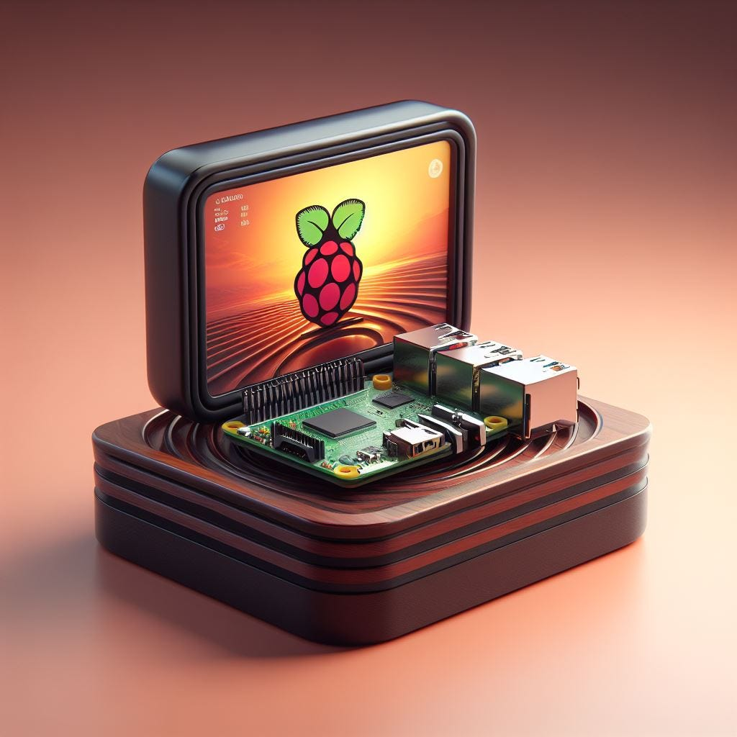
Comparison between Raspberry Pi and Arduino Uno

Slide 2
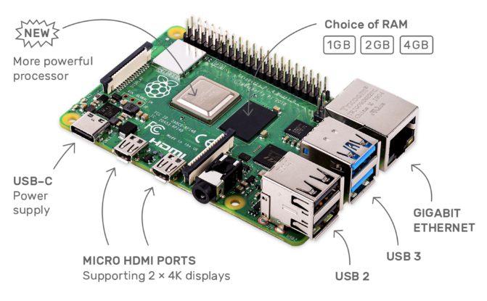
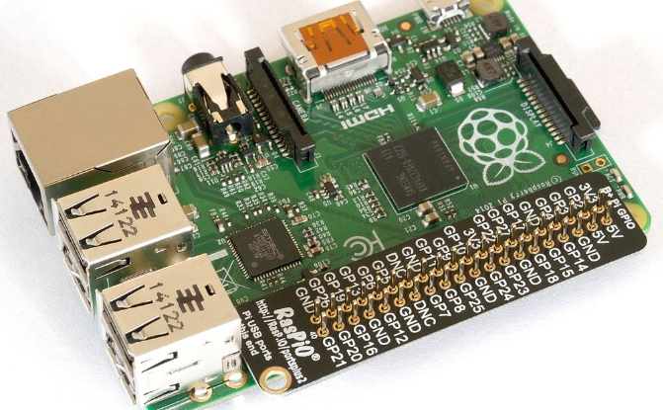
Overview of Raspberry Pi structure
Components
Connectivity
The Raspberry Pi comprises a central processing unit (CPU), memory, input/output ports, and a microSD card.
It offers various connectivity options, including USB ports, HDMI, Ethernet, and GPIO (General Purpose Input/Output) pins.

Slide 3
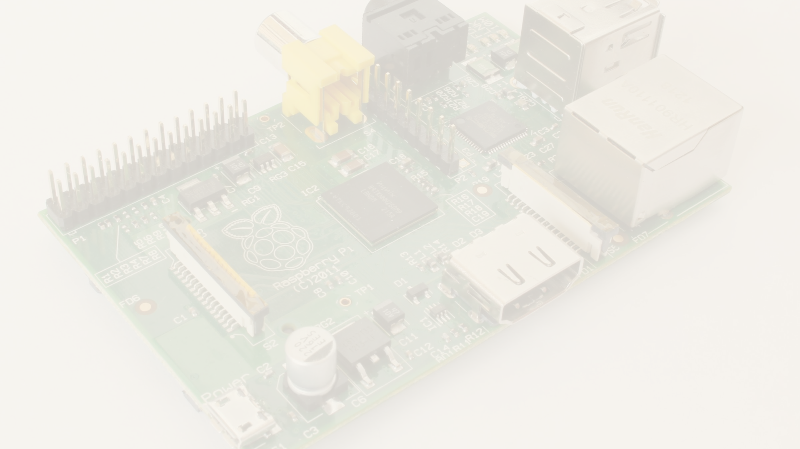
Overview of Raspberry Pi
1
SOC
2
Processing Power
3
Wide Range of Models
The Raspberry Pi is a small computer that offers a wide range of applications, contain RAM, ROM, etc..
System on chip (SOC)
It is equipped with a high-performance processor and can handle various tasks.
There are different models of Raspberry Pi, catering to different needs and budgets.
By raspberry pi you can send email, use internet, do electronic projects such as smart home, listen to music ,…

Slide 4
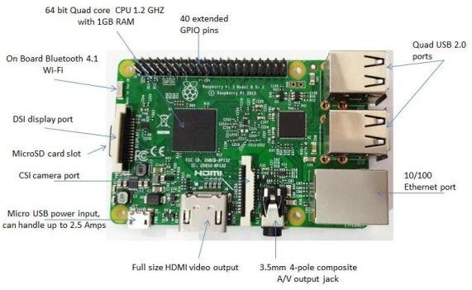
Overview of Raspberry Pi structure

Slide 5

Overview of Arduino Uno structure
Microcontroller-Based
Power Supply
Arduino Uno is built around a microcontroller that integrates the CPU, memory, and I/O interfaces on a single chip.
It can be powered via USB or an external power source, providing flexibility in its deployment.
Flash Memory
Arduino Uno features flash memory for storing programs and a wide range of input/output devices.

Slide 6
Comparison of hardware
Raspberry Pi | Arduino Uno
ARM family | ATMega family | Control unit
700MHZ to 1000MHZ | 16MHZ to 20MHZ | Speed
512MB | 2KB | RAM
SD card | 32KB | ROM
5V | 5-17 V | I/O voltage
Yes | No | Videos
320 to 700 mA | 42 mA | Current amps
8 | 14 | Digital pins
No | 6 – 10 | Analog pins

Slide 7
Comparison of hardware
Raspberry Pi | Arduino Uno
Yes | No | Ethernet
YES | NO | GPIO
Yes | No | Connect additional devices
Yes | No | Multi tasking
Yes | No | Connect to screens
Yes | No | Audio output
All linux language | C/C++/Scratch | Programming language
Expensive | Cheap | Cost
Yes | No | Videos

Slide 8
When to use both of them:
If you are looking for simplicity -> Uno
If you are looking for strength -> Raspberry pi
If you are looking for price -> Uno
If you are looking for energy consumption -> Uno
If you are looking for multitasking and operations at the same time -> Raspberry pi
If you are looking to connect media devices and monitors -> Raspberry pi

